Slide 1


Pivotal Cloud Foundry
2.5 hr Crash Course

Slide 2

Section 1 Pre-Requisites & INtro
Notes:
THIS SECTION INCORPORATES SLIDES FROM “PCF Basics and Arch 301” Deck

Slide 3
Pre-Requisites
Git clone crashcourse/sample apps (https://github.com/Pivotal-Field-Engineering/crashcourse.git)
2. Install the PCF Command Line Interface (CLI is available at https://cli.run.pivotal.io/stable?release=windows64&source=pws
)
3. Make sure you can Login with your credentials
$ cf login -a https://api.paas.ipacc.com -u user# -p user#
Notes:
api.paas.mia.ulti.io

Slide 4
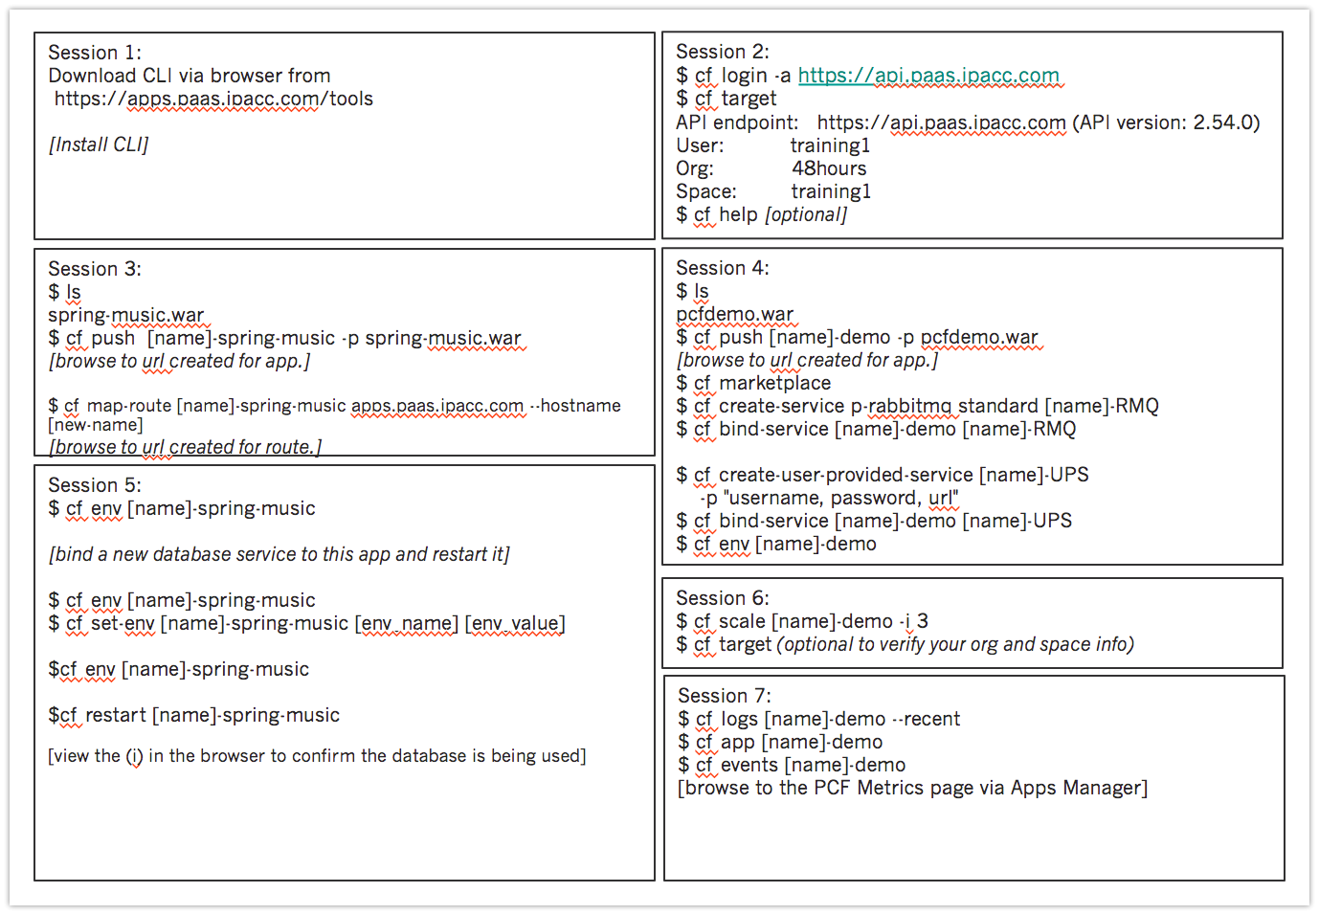
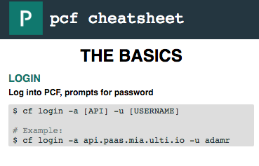
What to expect….
2.5 hours of theory and practice
9 Sections :
Intro
Login
Push
Services
Environment vars
Scaling
Monitoring
Languages
Help links
Notes:
http://cloudacademy.com/blog/cloud-foundry-benefits/

Slide 5
Cloud Foundry….
Open Source Cloud Computing Platform
Developed at VMware
Now owned by Pivotal Software
Pivotal is a Joint Venture of EMC, Vmware, GE, Msft, and Ford
Designed for
Fast application development and deployment.
Highly scalable and available architecture.
DevOps-friendly workflows.
Reduced chance of human error.
Multi-tenant compute efficiencies.
High degree of Operational support via autonomous resource mgmt.
Notes:
http://cloudacademy.com/blog/cloud-foundry-benefits/

Slide 6
How does it work?
apps
Cloud
Foundry
services
containers
BOSH
VMs
IaaS
Hardware

Slide 7
Section 2 CF Login & CF Target
Notes:
THIS SECTION INCORPORATES SLIDES FROM “PCF Basics and Arch 301” Deck

Slide 8
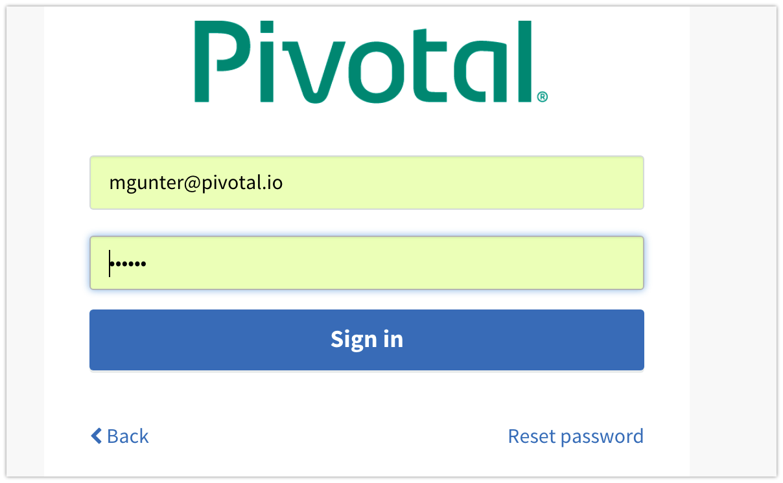
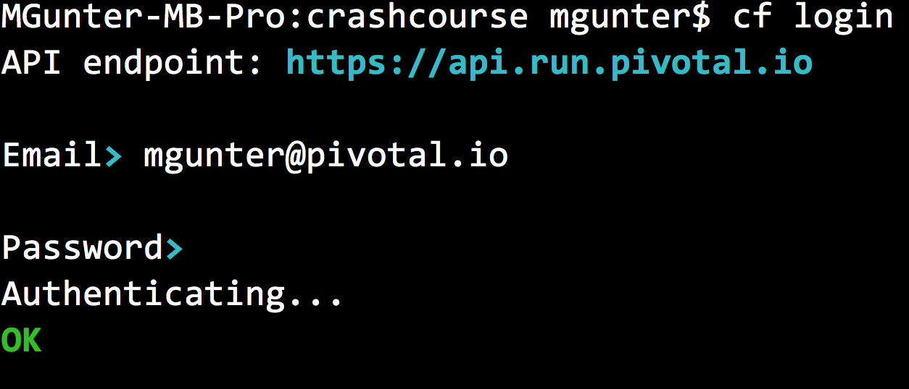
Apps Manager
CLI cf login….

Slide 9
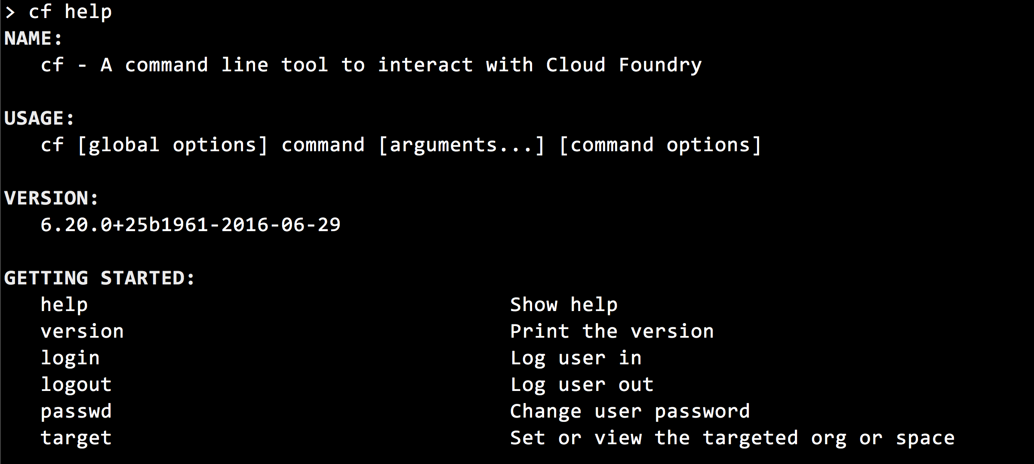
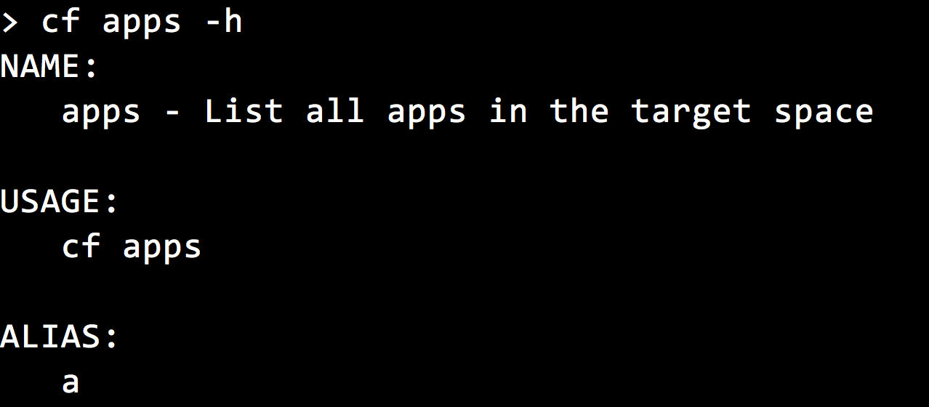
List Commands
Show help for a single command

Slide 10
Session 2:
$ cf login –a https://api.paas.ipacc.com
$ cf target API endpoint: https://api.paas.ipacc.com (API version: 2.54.0)
User: user
Org: SRE-org
Space: crashcourse
$ cf - -help [optional]

Slide 11
Section 3 CF Push & Run
Notes:
THIS SECTION INCORPORATES SLIDES FROM “PCF Basics and Arch 301” Deck

Slide 12

CF PUSH
Platform Runtime (Elastic Runtime)
Blobstore
Service
credentials
Upload app bits and metadata
DB
push app
+ app MD
Cloud Controller
Service Broker Node(s)
Create and bind services
Stage application
Deploy application
Manage application health
Router
Container Management - DIEGO
Cell
DEA
Brain
DEA
DEA
+
=
Notes:
We keep the cf push workflow simple and don’t get into the details of DIEGO. We only keep the BRAIN and Cell.
Cloud Foundry PaaS – Pushing an Application with Diego
App deployment: what has changed?
1- Domain specific (notion of apps) -> Abstractions (notions of LRPs and Tasks). App staging is a Task. App start is launching a LRP.
2- Platform specific (linux) -> Supporting multi platform (Windows & Linux) enabling running also .NET apps, thanks to our new Container implementation: Garden
What’s more, there is a 3rd workflow supported: Docker on Linux
3- New Auction-based workload scheduler: Cloud Controller no longer in charge of deciding where AIs are spun up. Auctioneer manages the process running an auction, making it more optimized.
With Diego in place, more loosely-coupled components take part in the process, stripping down the Cloud Controller from too many previous responsibilities, making it easier to maintain and evolve the entire architecture.
The Cloud Controller handles the routing of client requests internally through the Cloud Controller Bridge. It also manages the Blobstore to store packages and droplets and the DB to store App Metadata and Service credentials. Blobstore could be internal or external, depending on the setup.
A service gateway provides an interface for services (native or external).
More in the next slide about the Cloud Controller Bridge (CC-Bridge), the Bulletin Board System (BBS) and the Auctioneer in the next slide
Apps run in a CELL, part of the new Cloud Foundry Runtime, called Diego
Routers manage application traffic.
Diego handles all health management for apps (now LRPs), through a series of single-purpose components: Nsync (part of the CC-Bridge), BBS (part of Diego DB) and the Converger (part of the Diego Brain)
Apps are accessed directly through the router while web and CLI clients (e.g., vmc, STS) access Cloud Controller via RESTful services.

Slide 13
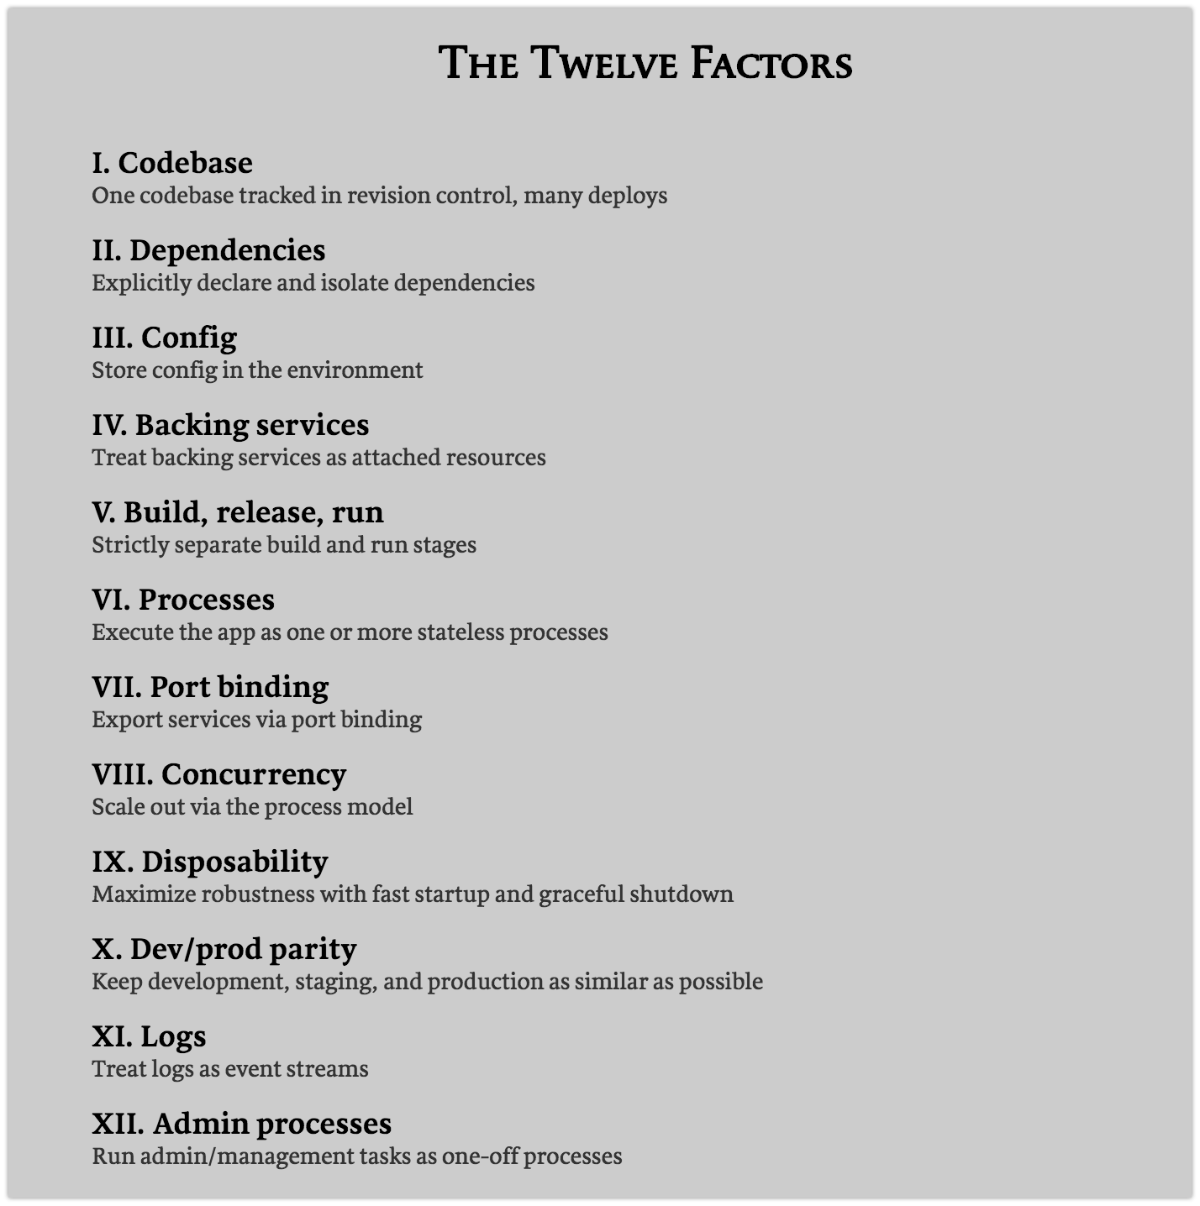

Slide 14
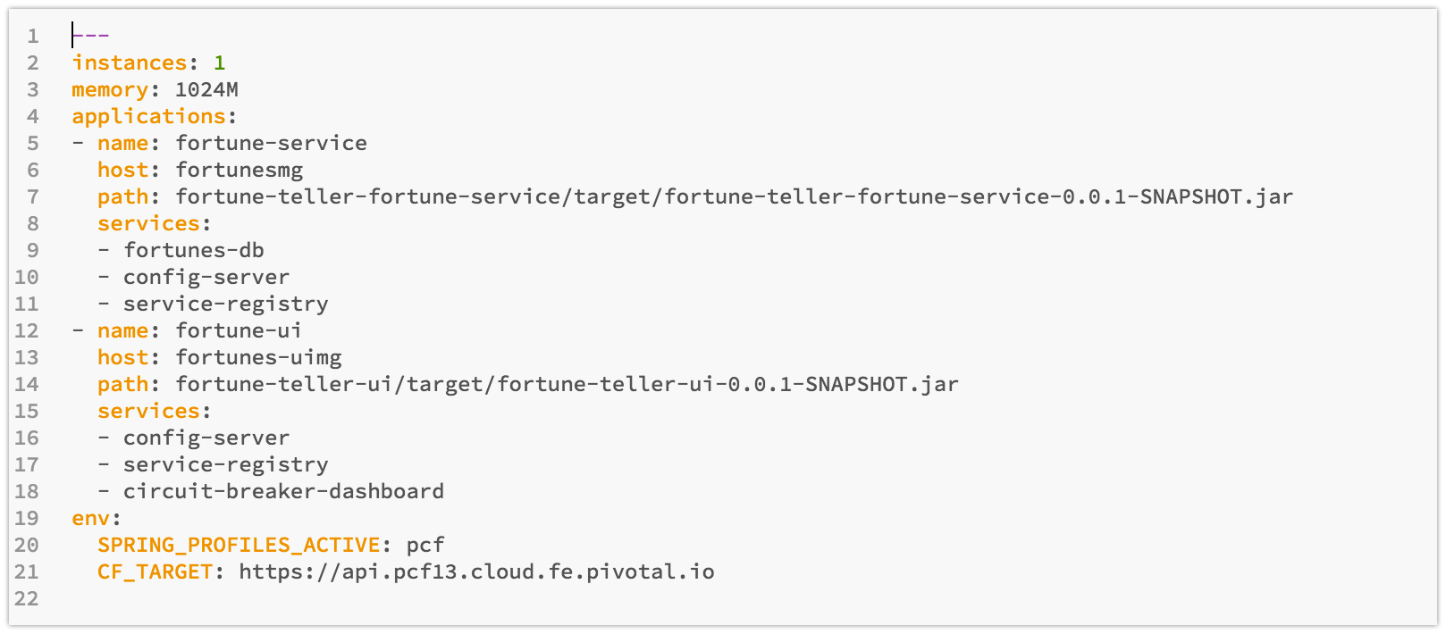
Manifest
manifest.yml
Instances
Memory
Multiple apps
Names, hosts, path
Services
Environment vars

Slide 15
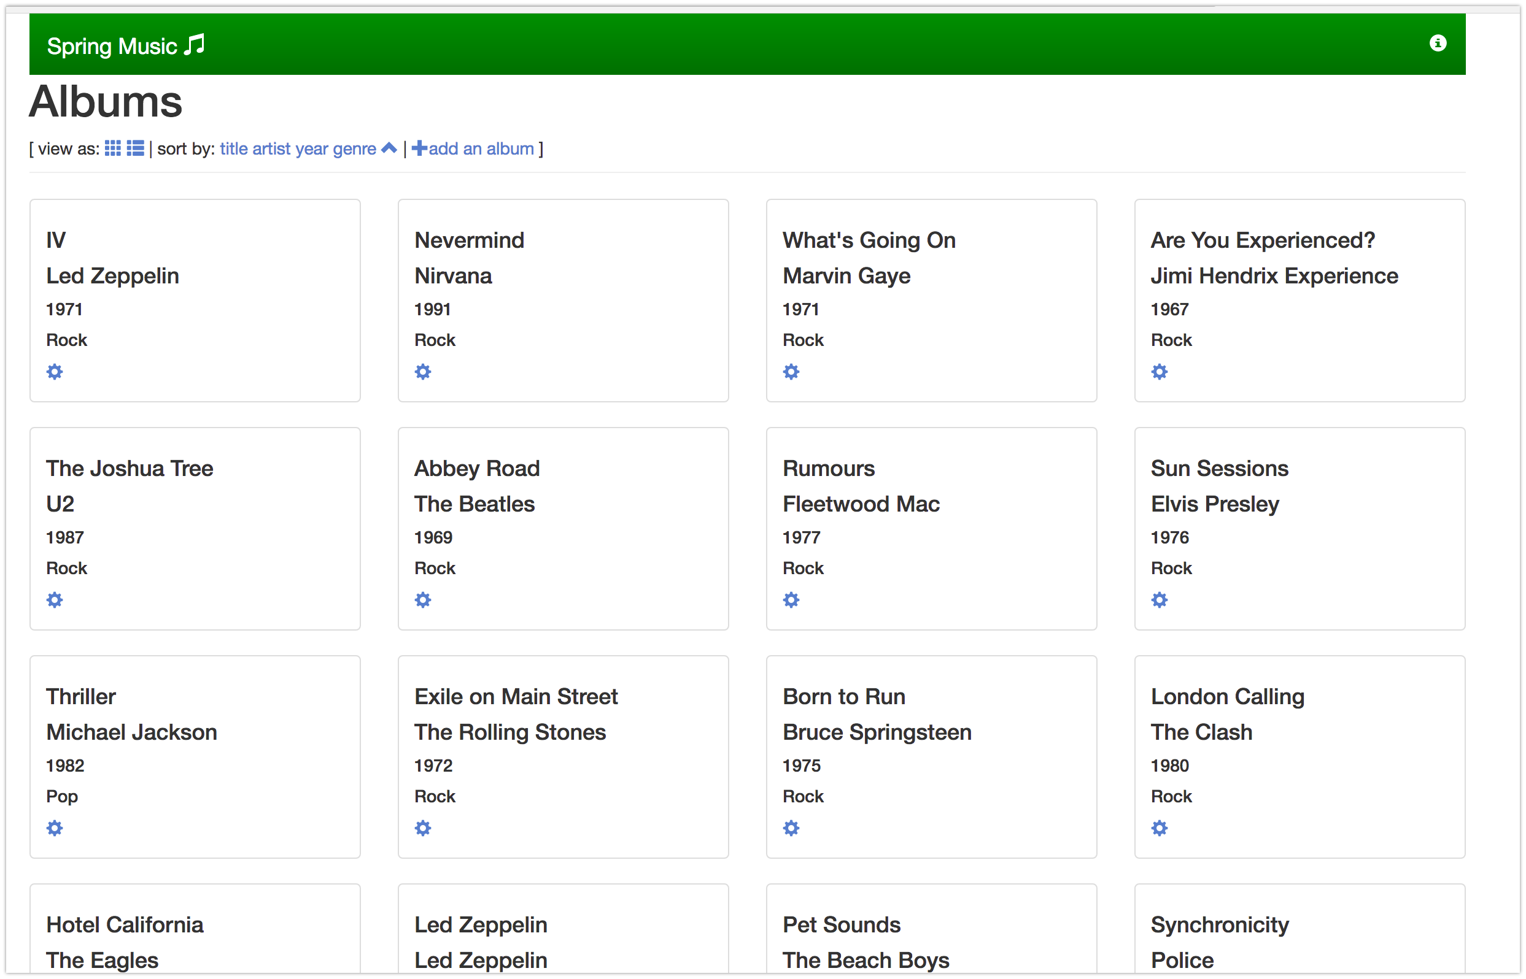
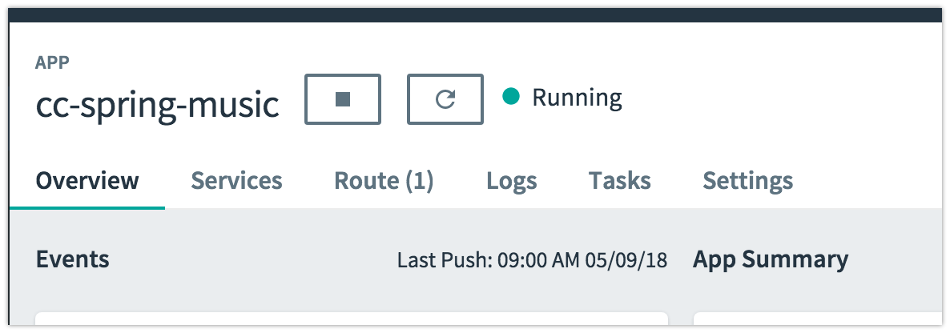

Slide 16
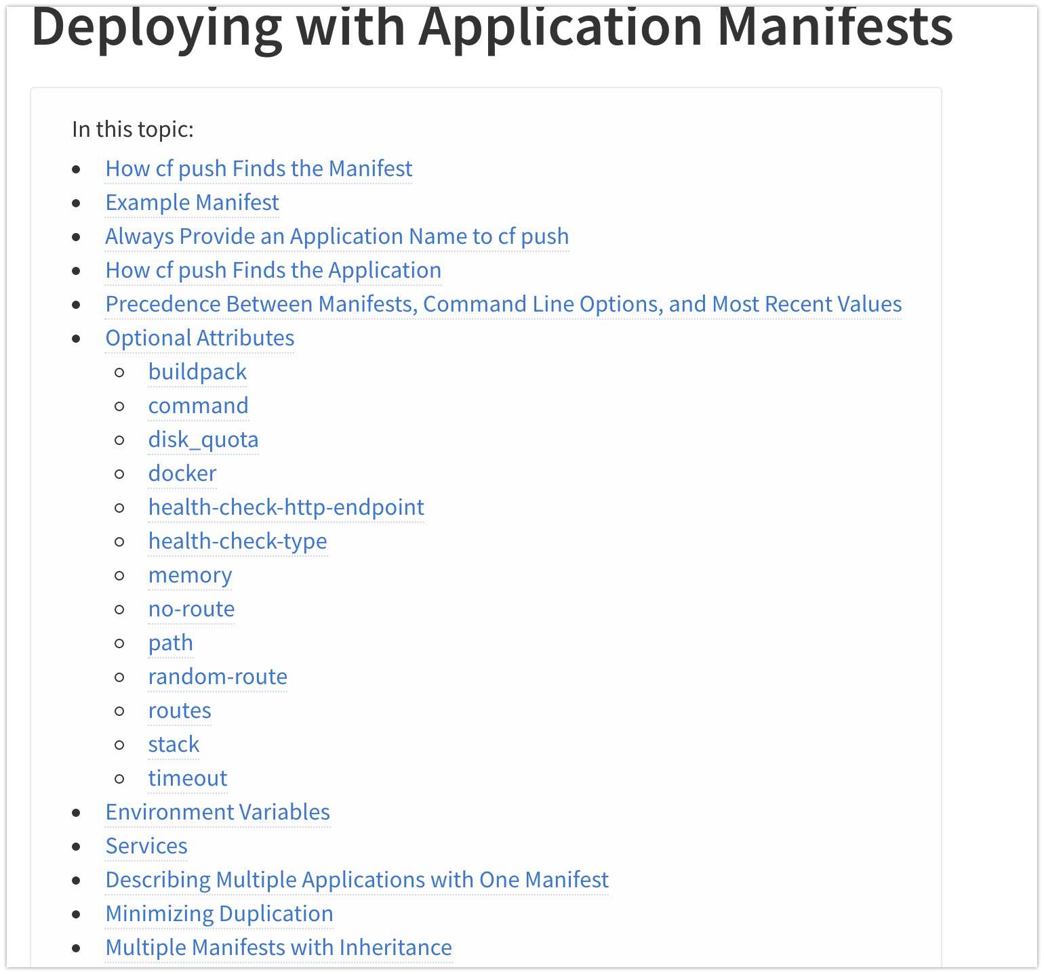
Documentation on Manifest.yml

Slide 17
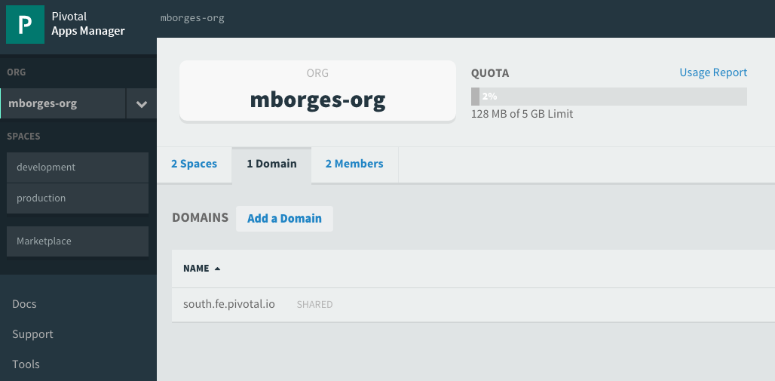
Domains
Each Cloud Foundry installation has a default app domain
Domains provide a namespace from which to create routes
Requests for any routes created from the domain will be routed to Elastic Runtime.
Domains can be shared or private in regards to PCF organizations
Notes:
https://docs.pivotal.io/pivotalcf/devguide/deploy-apps/routes-domains.html
Picture of PCF architecture HAProxy and Router using domain namesdns

Slide 18
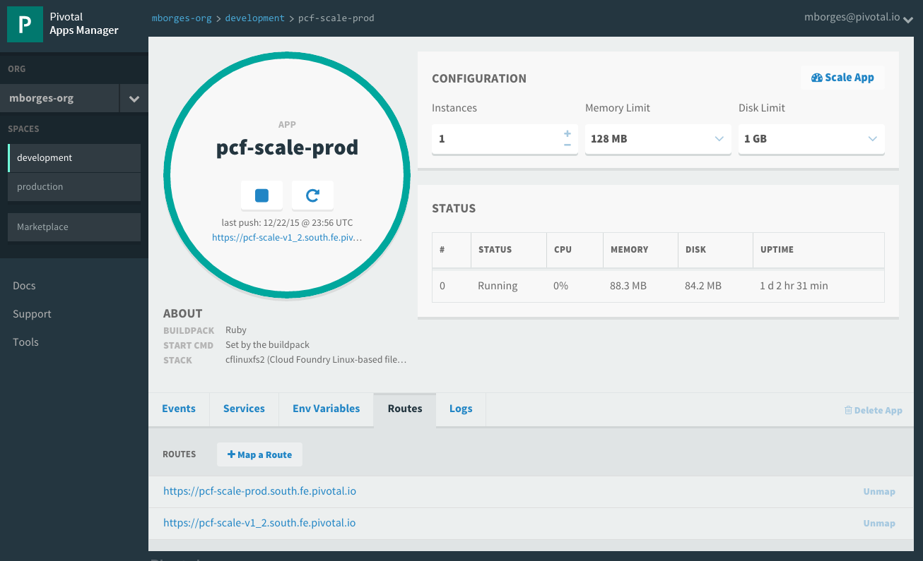
Routes
HTTP requests are routed to apps pushed by a “ROUTE”
Many Apps ….to a Route
Many Routes…. to an App
Routes belong to a space
Notes:
https://docs.pivotal.io/pivotalcf/devguide/deploy-apps/routes-domains.html
TDB: Consider adding a picture instead of just showing Apps Manager

Slide 19
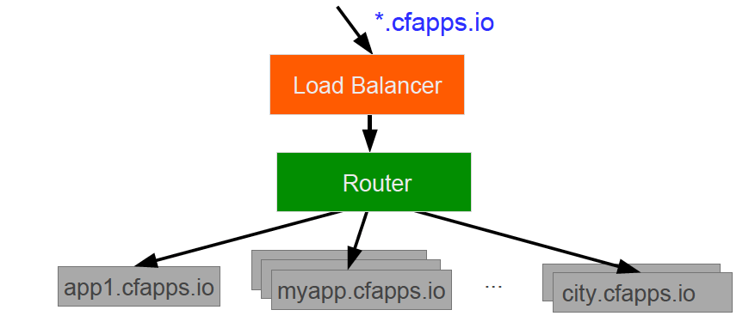
Routes and Domains
A wildcard entry (*) is added to the DNS for the app domain
The Router uses the subdomain to map to application instance(s)
Host and Domain are in a shared namespace.
No duplicates allowed!
Notes:
Move this slide to where we talk about Routes
https://docs.pivotal.io/pivotalcf/devguide/deploy-apps/routes-domains.html
Picture of PCF architecture HAProxy and Router using domain namesdns

Slide 20
Session 3:
$ ls spring-music.war
$ cf push [name]-spring-music –p spring-music.war
[browse to url created for app.]
$ cf map-route [name]-spring-music apps.mia.ulti.io --hostname [new-name]
[browse to url created for route.]

Slide 21
Section 4 CF MarketPlace & CF Bind
Notes:
THIS SECTION INCORPORATES SLIDES FROM “PCF Basics and Arch 301” Deck

Slide 22
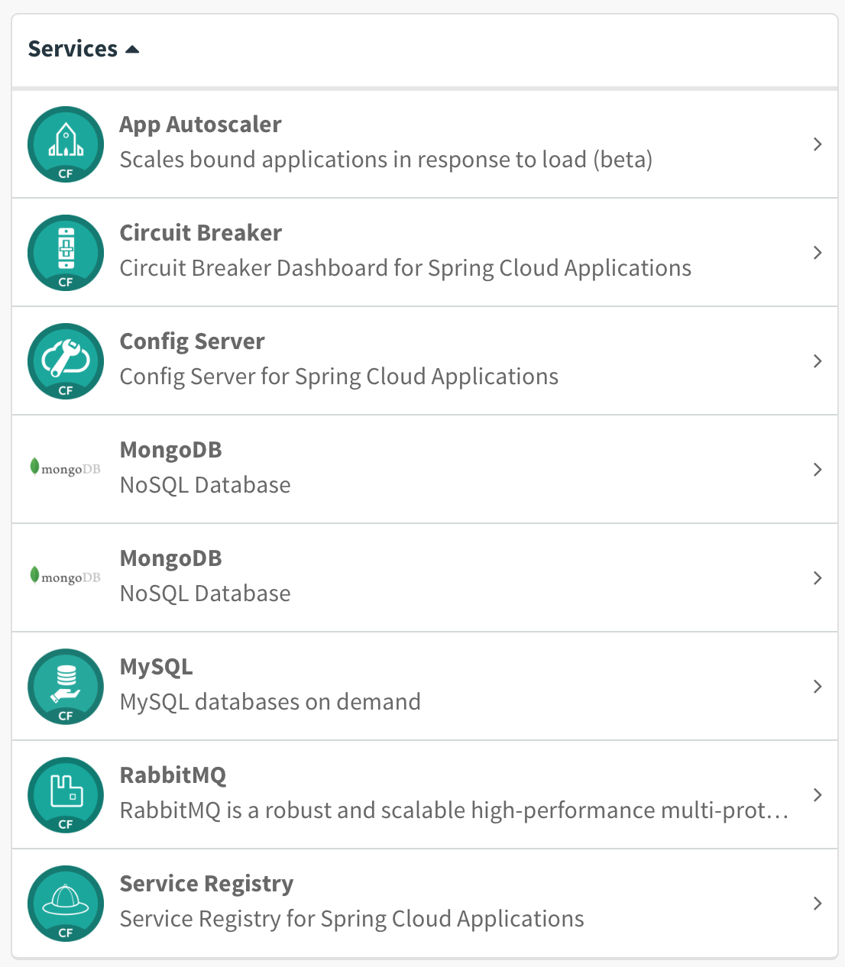

“Marketplace” of Managed Services
Managed Services are integrated with PCF by implementing a documented API.
A self-service catalog of databases, analytics and middleware technologies:

Slide 23
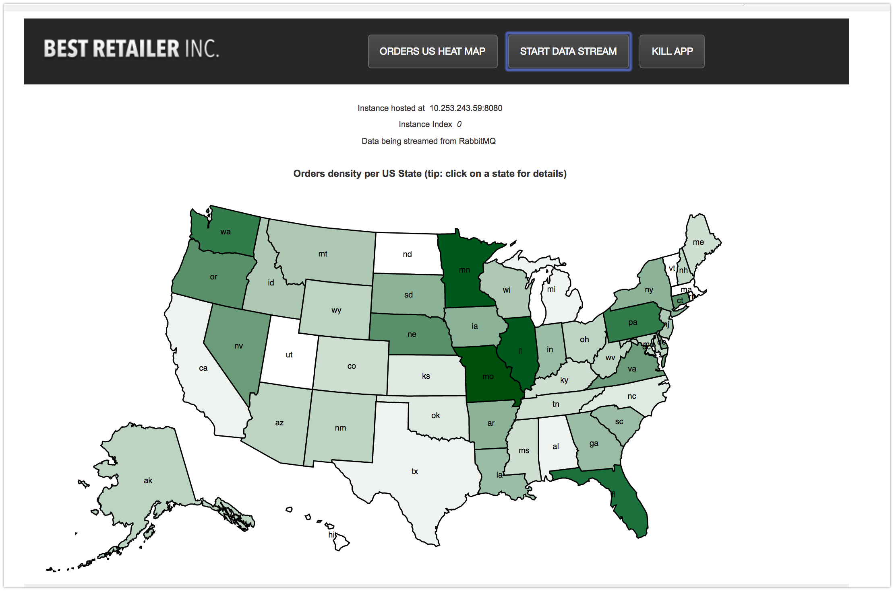
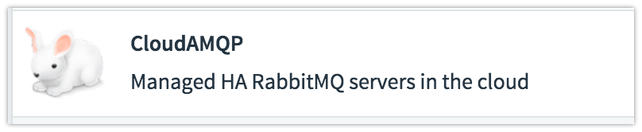
Push PCFDemo ….and Bind a RabbitMQ service

Slide 24
Creating and binding services
Service
credentials
DB
CLI
create service (HTTP)
Cloud Controller
create service (HTTP)
Service
Broker
reserve resources
Data
Service
Router
bind service (HTTP)
bind service (HTTP)
obtain connection data
Platform
Runtime
Notes:
NOTE: THIS SLIDE IS THE SAME WE USE IN THE PCF Basic and Arch 301 presentation – KEEP THEM IN SYNC

Slide 25
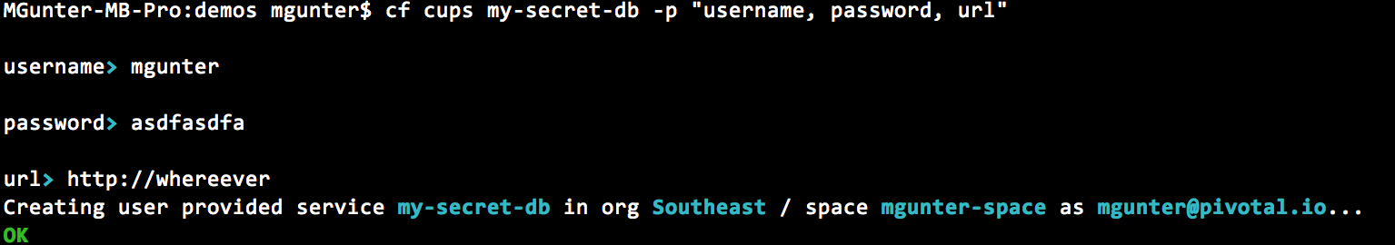
What about Services NOT in the marketplace?
Hard-code Connection Info
Environment Variables
User-Provided Services:

Slide 26
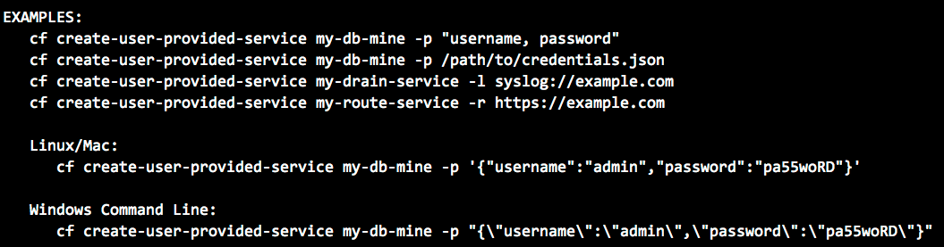
User-Provided Services

Slide 27
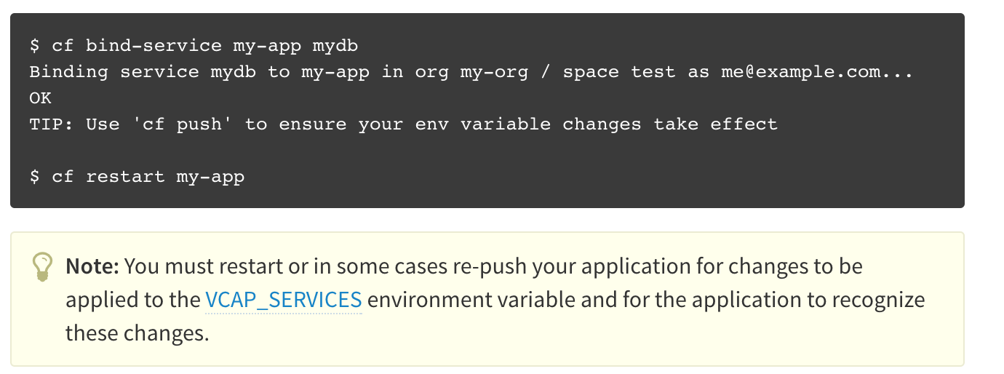
Binding Services to Apps

Slide 28
Session 4:
$ ls pcfdemo.war
$ cf push [name]-demo –p pcfdemo.war
[browse to url created for app.]
$ cf marketplace
$ cf create-service p-rabbitmq standard [name]-RMQ
$ cf bind-service [name]-demo [name]-RMQ
$ cf create-user-provided-service [name]-UPS -p "username, password, url”
$ cf bind-service [name]-demo [name]-UPS
$ cf env [name]-demo

Slide 29
Section 5 CF ENV
Notes:
THIS SECTION INCORPORATES SLIDES FROM “PCF Basics and Arch 301” Deck

Slide 30
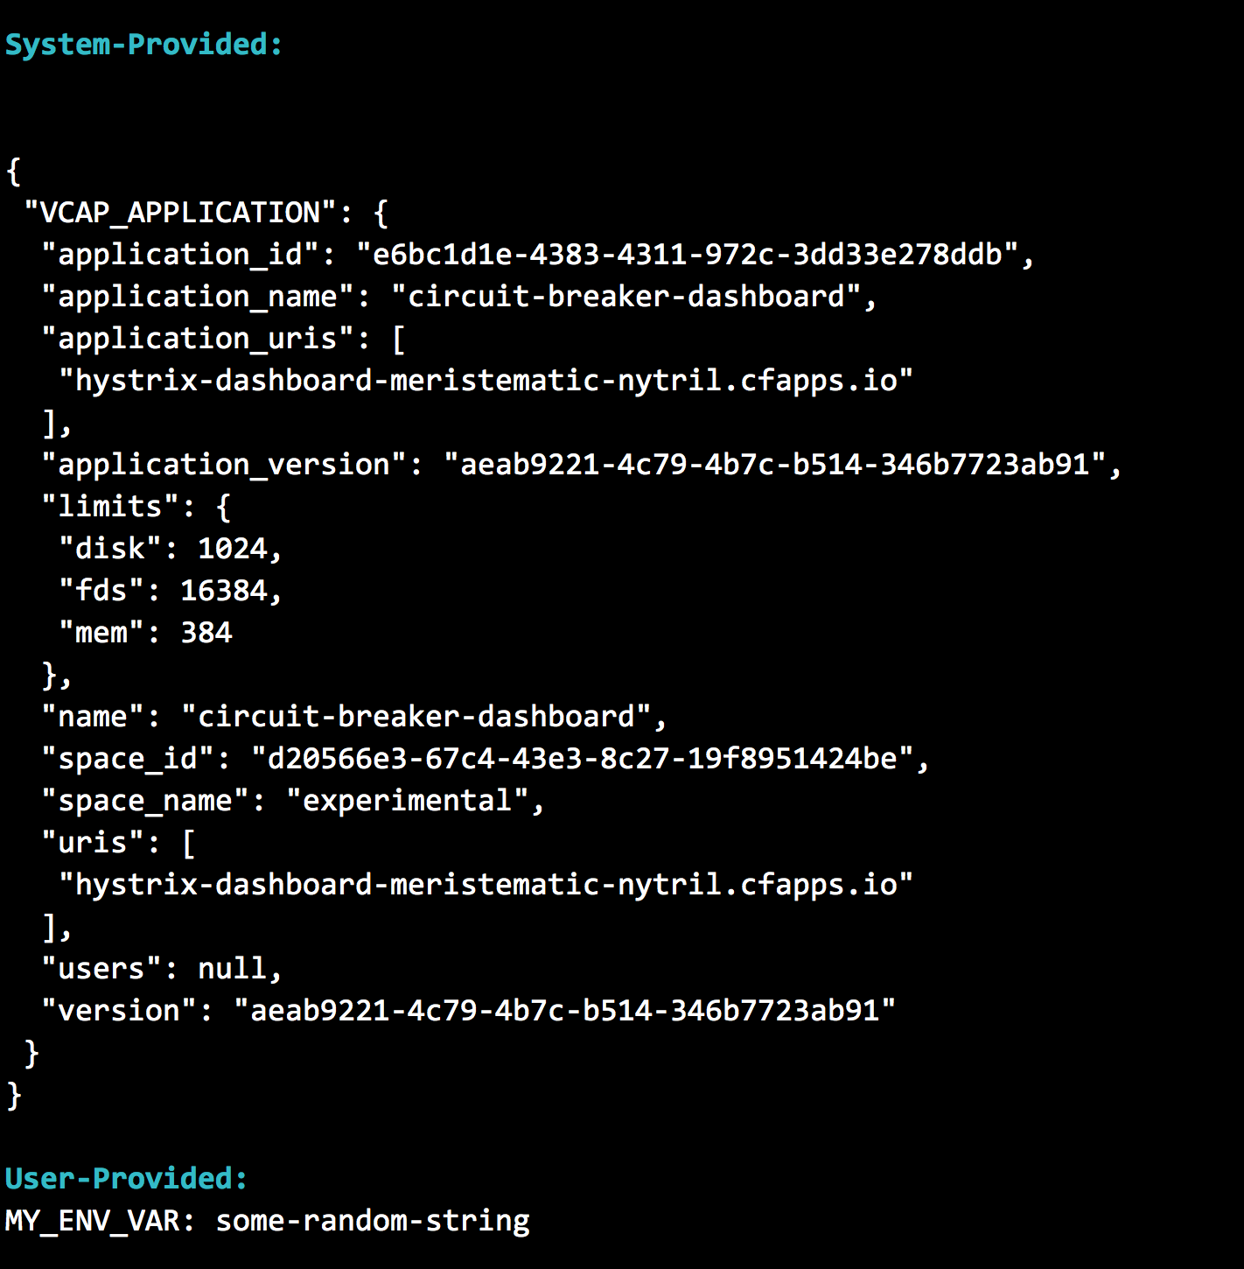
Env Vars

Slide 31
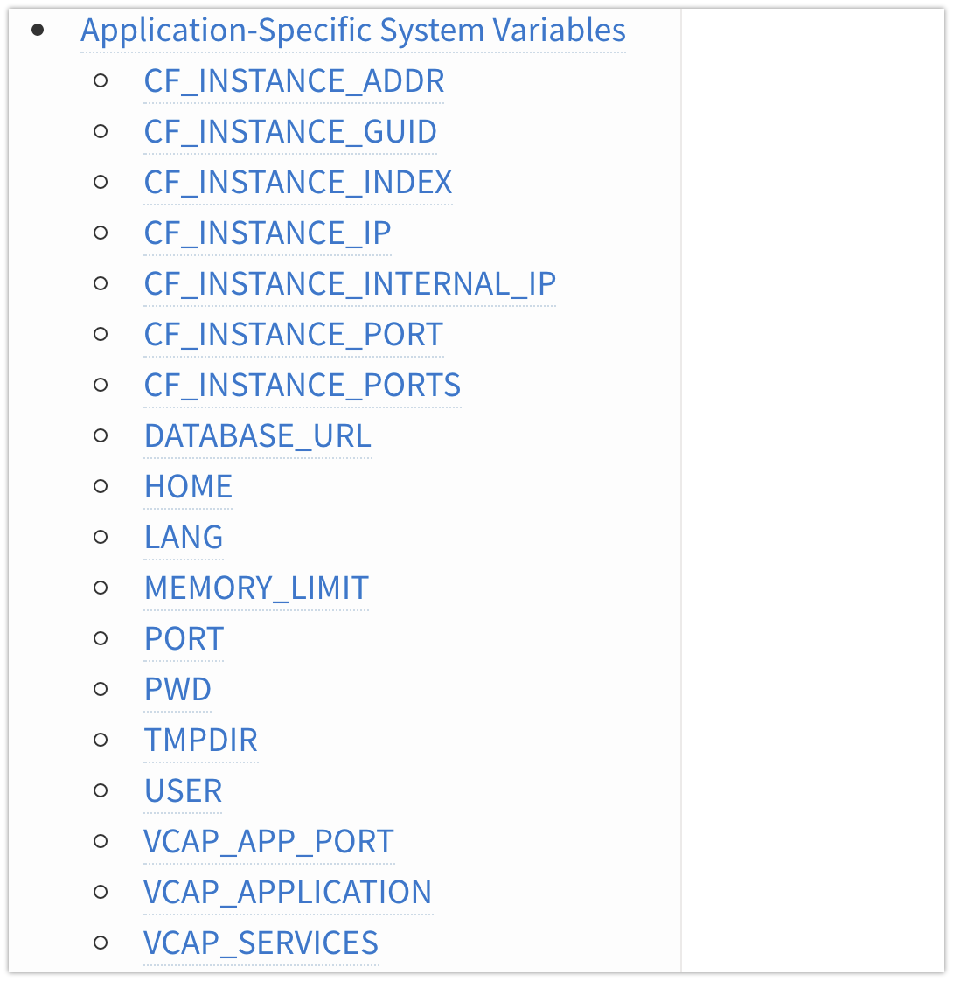
Other Environment Variables

Slide 32
Session 5:
$ cf env [name]-spring-music
[Option - bind a new database service to this app and restart it]
$ cf env [name]-spring-music
$ cf set-env [env_name] [env_value]
$cf env [name]-spring-music
$cf restart [name]-spring-music
[view the (i) in the browser to confirm the database is being used]

Slide 33
Section 6 CF Scale & quota/Roles
Notes:
THIS SECTION INCORPORATES SLIDES FROM “PCF Basics and Arch 301” Deck

Slide 34
The App-Container Approach - Scaling
Blobstore
Cloud Controller
Container Management - DIEGO
Access App
Router
Brain
Cell
Cell
Cell
Platform Runtime
Notes:
https://github.com/cloudfoundry-incubator/diego-design-notes
At the core of Diego
A distributed scheduling algorithm which orchestrates where containers go and hence where application instance processes are run
Optimizing for application workloads
Implements Demand Driven scheduling of workload
Auctioneer says "I have N pieces of work, who wants them?"
Worker cells then join an auction and the winning cell of each auctioned-off piece of work gets that piece of work
Components of Diego
Tasks & Long Running Processes (LRPs)
Tasks: are processes that are run once and have a finite running time. This might be a script or job to process a piece of data
LRP: This might be a web-server or some other service that continuously accepts input and processes
Tasks are not included in Auction
Cells
Cells are where the Tasks and LRPs are run
These are most analogous to DEAs in the current Cloud Foundry architecture.
Generally one Cell per VM
Brain – implements the core scheduling (auction algorithm) functionality of Diego
Bulletin Board System/Store (BBS)
Where state of Diego cluster is stored
Up to date cache of cluster state
“Holds” CF actions
Start/Stop instances
Start one-off task processes
Backed by ETCD which acts as consistent store
Components of Diego Brain
Auctioneer – holds auctions for LRPs and Tasks
Also determines which instances are removed when scaling down
Converger - Keeps cluster state consistent using eventually consistent model
Ensures cluster state is consistent with the desired state, that is, performs convergence
Provides fault tolerance for Tasks and LRPs
Updates BBS with state of cluster
Places requests on BBS
Metric Server – Reads from Metron agents, publishes them to Doppler
Components of Diego Cell
Rep - Represents Cell in Diego
Mediates all communication with BBS where cluster state is maintained
Participates in auction to accept Tasks/LRPs
Runs Tasks & LRPs by working with Executor
Executor –
Implements HTTP API to Create and Delete Containers
Implements Executor Actions such as Run, Download, Upload, Parallel etc
Streams Stdout & Stderr to Metron agent running in the Cell
Garden – the Linux container for Diego
Garden API – the Linux Garden API implementation
Garden-Linux – the Linux container backend implementation
Isolates network, disk, memory, CPU; performs resource management
Runs droplets, tasks, other containers (Docker)
Metron Agent - Forwards application logs and application/Diego metrics to doppler (loggregator)

Slide 35
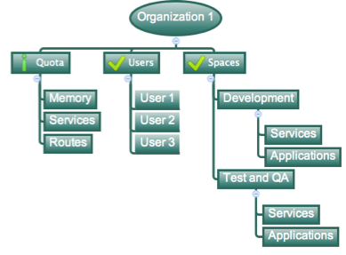
Organizations
Top-most administrative unit
Logical division division
Each organization has its own users and assigned quota
User permissions / Roles are specified per space within an organization
Sub-divided into spaces
Notes:
TDB: layout

Slide 36

Spaces
Logical sub-division within an organization
Users authorized at an organization level can have different roles per space
Services, Routes, and Applications are created / target per Space
Can also have “space quota”
Notes:
TDB: layout

Slide 37
Session 6:
$ cf scale [name]-demo -i 3
$ cf app [name]-demo
$ cf target (optional to verify your org and space info)
$ cf org [org name]
$ cf space [space name]

Slide 38
Section 7 Health Monitoring & Troubleshooting
Notes:
THIS SECTION INCORPORATES SLIDES FROM “PCF Basics and Arch 301” Deck

Slide 39

Viewing your app “vitals”
cf events [app_name]
cf app [app_name]
cf logs [app_name] --recent
PCF Metrics page

Slide 40
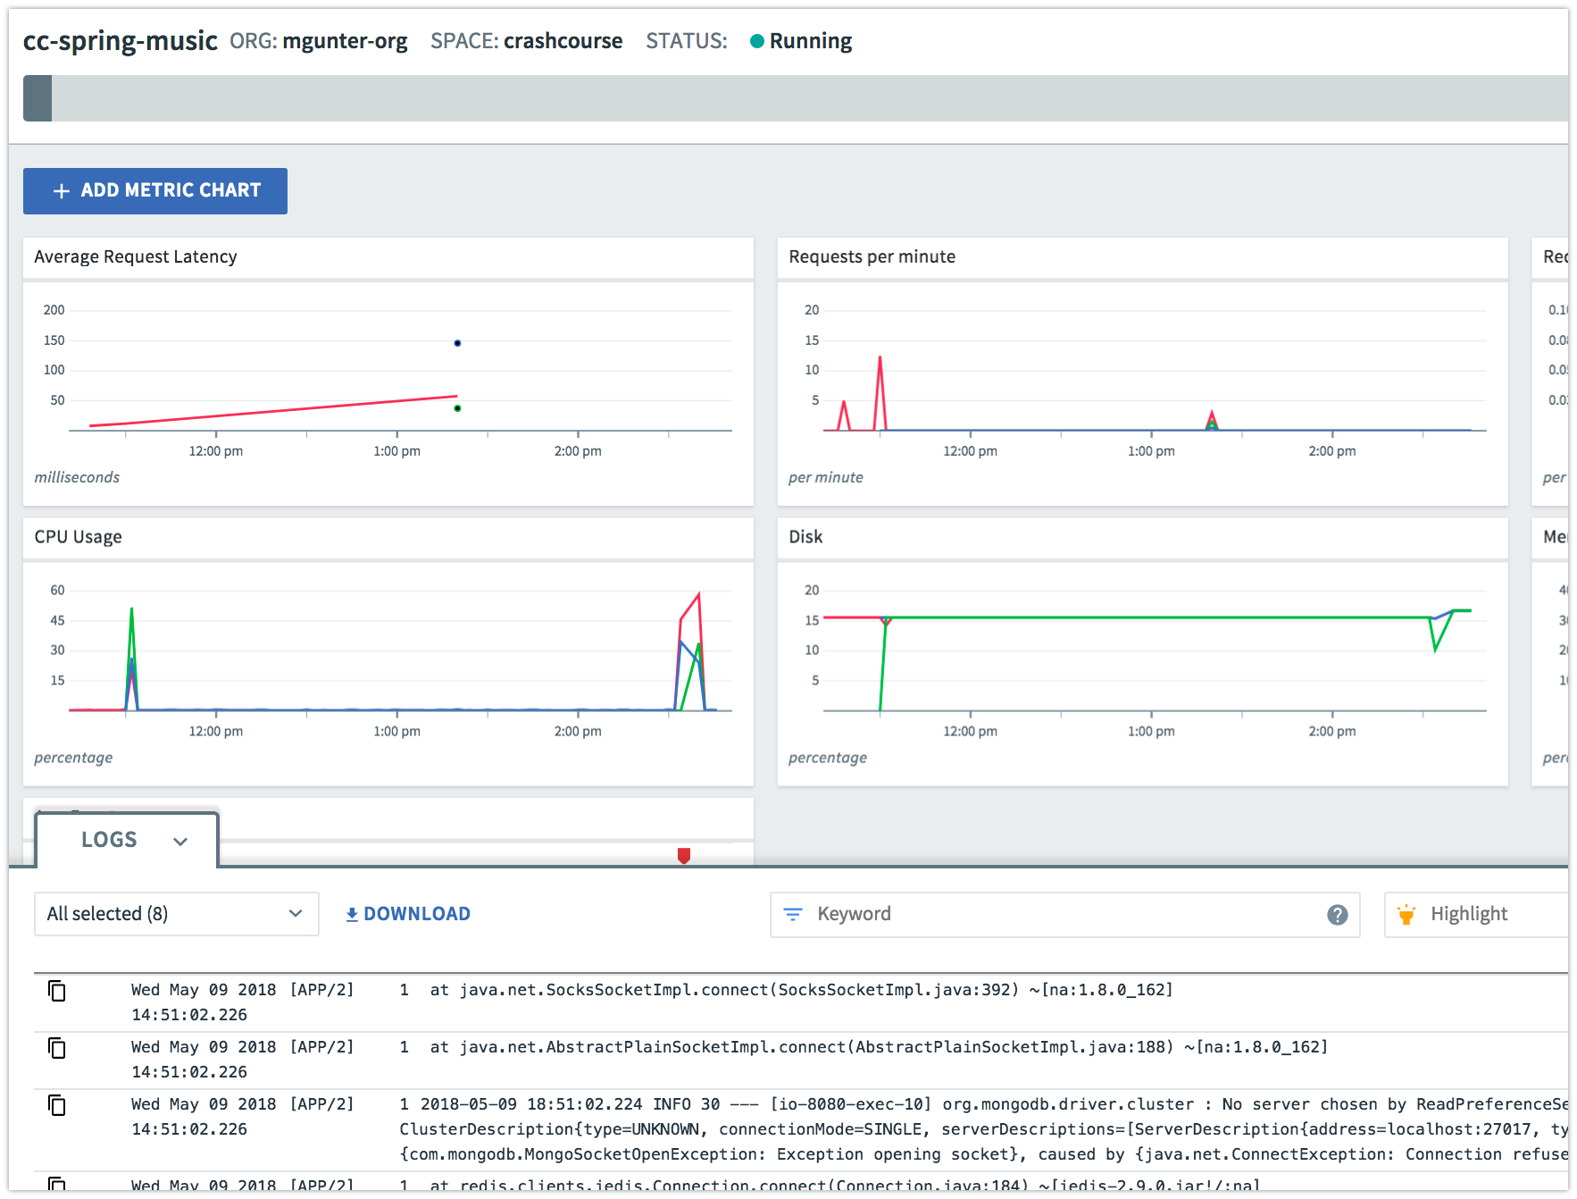
PCF Metrics….
Detailed performance info about your app.

Slide 41
Session 7:
$ cf logs [name]-demo --recent
$ cf app [name]-demo
$ cf events [name]-demo
[browse to the PCF Metrics page via Apps Manager]
apps.paas.mia.ulti.io

Slide 42
Section 8 Languages & Buildpacks
Notes:
THIS SECTION INCORPORATES SLIDES FROM “PCF Basics and Arch 301” Deck

Slide 43
Platform Runtime – Buildpacks
Container image
application layer
Pivotal CF supports - 6 Language Buildpacks
Java, Node, Python, Ruby, Go, .Net Core(beta) , Static_file
Devs can focus on (& push) just the app code
PCF creates the container image for you
runtime layer*
Dev Supported
PCF Supported
OS image
App container
Ops Supported
linux host & kernel
* Devs may bring a custom buildpack
Notes:
Introduction to buildpacks
Here we can compare and contrast with other container solutions like docker. We can bring up the advantages on the fact the container is built on the fly and that the buildpack provides consistency in building, updating and patching container images. Sometimes infrastructure people get’s concerned about the fact we bring our own OS images (stemcells) in regards to their “special” security and other needs. We need to find a subtle way to explain these “special” needs are often part of the problem. We should defer any detail security discussion as it can get hairy.

Slide 44
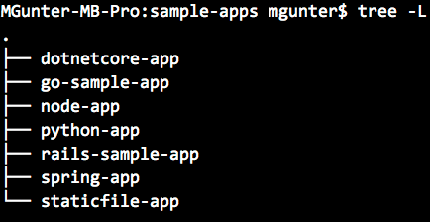
Push your own Example App
Use one of the examples:
Make a change and re-push.

Slide 45
Section 9 Where to go for Help?
Notes:
THIS SECTION INCORPORATES SLIDES FROM “PCF Basics and Arch 301” Deck

Slide 46
Informational Resources:
CF Docs: https://docs.cloudfoundry.org/
PCF Docs: https://docs.pivotal.io/pivotalcf
CF Basics Tutorial: http://basics-workshop.cloudfoundry.org/

Slide 47
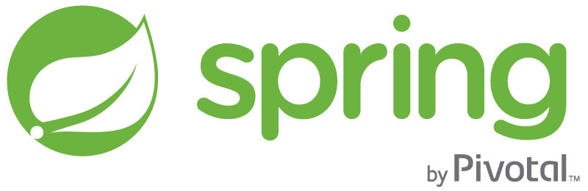

Support for PCF Buildpacks, Spring, and Tomcat
runtime layer
Buildpacks support
Java, Node, Python, Ruby, Go, .Net Core(beta), Static_file
Enterprise Middleware Support
Apache Tomcat Support from #1 Committer
Enterprise Framework Support
Spring is the #1 Enterprise Java Framework
Support.pivotal.io

Slide 48
Informational Resources:
CF Docs: https://docs.cloudfoundry.org/
PCF Docs: https://docs.pivotal.io/pivotalcf
CF Basics Tutorial: http://basics-workshop.cloudfoundry.org/

Slide 49
Session 1:
Download CLI via browser from
https://apps.paas.ipacc.com/tools
[Install CLI]
Session 2:
$ cf login -a https://api.paas.ipacc.com
$ cf target API endpoint: https://api.paas.ipacc.com (API version: 2.54.0)
User: training1
Org: 48hours
Space: training1
$ cf help [optional]
Session 3:
$ ls spring-music.war
$ cf push [name]-spring-music -p spring-music.war
[browse to url created for app.]
$ cf map-route [name]-spring-music apps.paas.ipacc.com --hostname [new-name]
[browse to url created for route.]
Session 4:
$ ls pcfdemo.war
$ cf push [name]-demo -p pcfdemo.war
[browse to url created for app.]
$ cf marketplace
$ cf create-service p-rabbitmq standard [name]-RMQ
$ cf bind-service [name]-demo [name]-RMQ
$ cf create-user-provided-service [name]-UPS
-p "username, password, url"
$ cf bind-service [name]-demo [name]-UPS
$ cf env [name]-demo
Session 5:
$ cf env [name]-spring-music
[bind a new database service to this app and restart it]
$ cf env [name]-spring-music
$ cf set-env [name]-spring-music [env_name] [env_value]
$cf env [name]-spring-music
$cf restart [name]-spring-music
[view the (i) in the browser to confirm the database is being used]
Session 6:
$ cf scale [name]-demo -i 3
$ cf target (optional to verify your org and space info)
Session 7:
$ cf logs [name]-demo --recent
$ cf app [name]-demo
$ cf events [name]-demo
[browse to the PCF Metrics page via Apps Manager]
Notes:
my-db-mine -p "username, password"

